Slide 1

MATH30
Probability and Statistics

Slide 2
The Concept of Probability
In any random experiment there is always uncertainty as to whether a particular event will or will not occur. As a measure of the chance, or probability, with which we can expect the event to occur, it is convenient to assign a number between 0 and 1. If we are sure or certain that the event will occur, we say that its probability is 100% or 1, but if we are sure that the event will not occur, we say that its probability is zero. If for example, the probability is ¼, we would say that there is a 25% chance it will occur and a 75% chance that it will not occur. Equivalently, we can say that the odds against its occurrence are 75% to 25%, or 3 to 1.

Slide 3
The Concept of Probability
There are two important procedures by means of which we can estimate the probability of an event.
CLASSICAL APPROACH. If an event can occur in h different ways out of a total number of n possible ways, all of which are equally likely, then the probability of the event is h/n.
EXAMPLE: Suppose we want to know the probability that a head will turn up in a single toss of coin. Since there are two equally likely ways in which the coin can come up−namely, heads and tails (assuming it does not roll away or stand on its edge)−and of these two ways a head can arise only one way, we reason that the required probability is ½. In arriving at this, we assume that the coin is fair, i.e., not loaded in any way.

Slide 4
The Concept of Probability
FREQUENCY APPROACH. If after n repetitions of an experiment, where n is very large, an event is observed to occur in h of these, then the probability of the event is h/n. This is also called the empirical probability of the event.
EXAMPLE: If we toss a coin 1000 times and find that it comes up heads 532 times, we estimate the probability of a head coming up to be 532/1000 = 0.532.

Slide 5
Applications of Probability
Reliability Engineering
Reliability theory is concerned with the duration of the useful life of components and systems of components. System failure times are unpredictable. Thus, the time until a system fails, which is referred to as the time to failure of the system, is usually modeled by a probabilistic functions.

Slide 6
Applications of Probability
Quality Control
Quality control deals with the inspection of finished products to ensure that they meet the desired requirements and specifications. One way to perform the quality control function is to physically test/inspect each product as it comes off the production line. However, this is a very costly way to do it. The practical method is to randomly select a sample of the product from a lot and test each item in the sample.

Slide 7
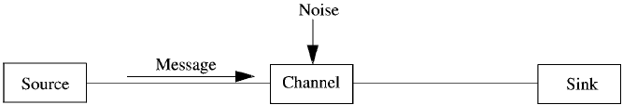
Applications of Probability
Channel Noise
Noise is an unwanted signal. A message transmitted from a source passes through a channel where it is subject to different kinds of random disturbances that can introduce errors in the message received at the sink. That is, channel noise corrupts messages, as shown in Figure 1.2.
Figure 1.2 Model of a Communication System

Slide 8
Applications of Probability
Channel Noise
Since noise is a random signal, one of the performance issues is the probability that the received message was not corrupted by noise. Thus, probability plays an important role in evaluating the performance of noisy communication channels.

Slide 9
Applications of Probability
System Simulation
The difficulty in providing an exact solution of physical problems involving random phenomena arises from that fact that such problems are very complex, which is the case, for example, when the system has unusual properties. One way to deal with these problems is to provide an approximate solution, which attempts to make simplifying assumptions that enable the problem to be solved analytically. Another method is to use computer simulation, which imitates the physical process. Even when an approximate solution is obtained, it is always advisable to use simulation to validate the assumptions.

Slide 10
Applications of Probability
System Simulation
A simulation model describes the operation of a system in terms of individual events of the individual elements in the system. The model includes the interrelationships among the different elements and allows the effects of the elements’ actions on each other to be captured as a dynamic process.
The key to a simulation model is the generation of random numbers that can be used to represent events−such as arrival of customers at a bank−in the system being modeled. Because these events are random in nature, the random numbers are used to drive the probability distributions that characterize them. Thus, knowledge of probability theory is essential for a meaningful analysis.

Slide 11
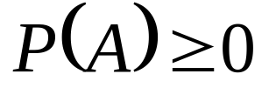
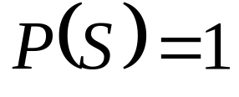
The Axioms of Probability
Suppose we have a sample space S. If S is discrete, all subsets correspond to events and conversely, but if S is nondiscrete, only special subsets (called measurable) correspond to events. To each event A in the class C of events, we associate a real number P(A). Then P is called a probability function, and P(A) the probability of the event A, if the following axioms are satisfied.
For every event A in the class C,
For the sure or certain event S in the class C,

Slide 12
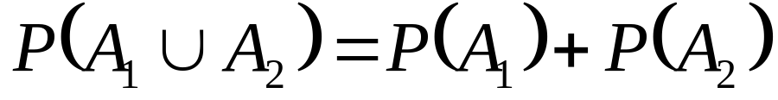
The Axioms of Probability
For any number of mutually exclusive events A₁, A₂,…, in the class C,
In particular, for mutually exclusive events A₁, A₂,

Slide 13

Some Important Theorems on Probability
If A₁ A₂, then P(A₁) ≤ P(A₂) and P(A₂ − A₁) = P(A₂) − P(A₁).
For every event A,
0 ≤ P(A) ≤ 1,
i.e., a probability is between 0 and 1.
P(Ø) = 0
i.e., the impossible event has probability zero.
If A′ is the complement of A, then
P(A′) = 1 − P(A)

Slide 14
Some Important Theorems on Probability
If A = A₁ U A₂ U … U A_{n}, where A₁, A₂,…, An are mutually exclusive events, then
P(A) = P(A₁) + P(A₂) + … + P(A_{n})
In particular, if A = S, the sample space, then
P(A₁) + P(A₂) + … + P(A_{n}) = 1
If A and B are any two events, then
P(A U B) = P(A) + P(B) − P(A ∩ B)
More generally, if A₁, A₂, A₃ are any three events, then
P(A₁ U A₂ U A₃) = P(A₁) + P(A₂) + P(A₃) − P(A₁ ∩ A₂) − P(A₂ ∩ A₃) − P(A₃ ∩ A₁) + P(A₁ ∩ A₂ ∩ A₃)
Generalizations to n events can also be made.

Slide 15
Some Important Theorems on Probability
For any events A and B,
P(A) = P(A ∩ B) + P(A ∩ B′)
If an event A must result in the occurrence of one of the mutually exclusive events A₁, A₂, …, A_{n}, then
P(A) = P(A ∩ A₁) + P(A ∩ A₂) + … + P(A ∩ A_{n})

Slide 16
Assignment of Probabilities
If a sample space S consists of a finite number of outcomes a₁, a₂,…, a_{n}, then by theorem 5,
P(A₁) + P(A₂) +…+ P(A_{n}) = 1
where A₁, A₂,…, A_{n} are elementary events given by A_{i} = {a_{i}}.
It follows that we can arbitrarily choose any nonnegative numbers for the probabilities of these simple events as long as the equation above is satisfied. In particular, if we assume equal probabilities for all simple events, then
P(A_{k}) = 1/n, k = 1, 2,…, n
and if A is any event made of h such simple events, we have
P(A) = h/n
This is equivalent to the classical approach to probability.

Slide 17
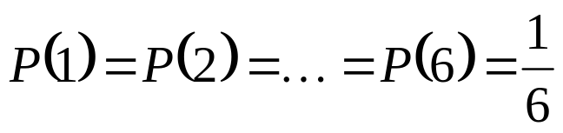
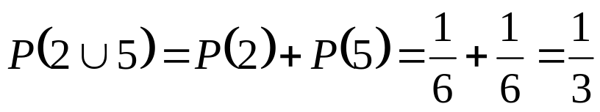
Example
A single die is tossed once. Find the probability of a 2 or a 5 turning up.
The sample space is S = {1, 2, 3, 4, 5, 6}. If we assign equal probabilities to the sample points, i.e., if we assume that the die is fair, then
The event that either 2 or 5 turns up is indicated by 2 U 5. Therefore,

Slide 18
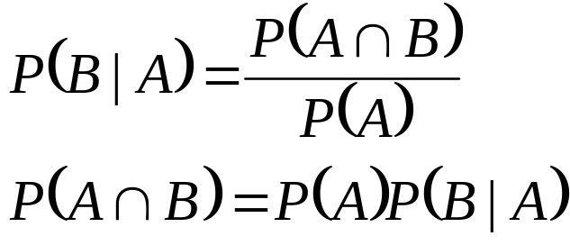
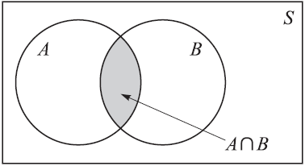
Conditional Probability
Let A and B two events such that P(A) > 0. Denote P(B | A) the probability of B given that A has occurred. Since A is known to have occurred, it becomes the new sample space replacing the original S. From this we are led to the definition

Slide 19
Conditional Probability
In words, P(A ∩ B) = P(A)P(B | A) says that the probability that both A and B occur is equal to the probability that A occurs times the probability that B occurs given that A has occurred. We call P(B|A) the conditional probability of B given A, i.e., the probability that B will occur given that A has occurred.

Slide 20
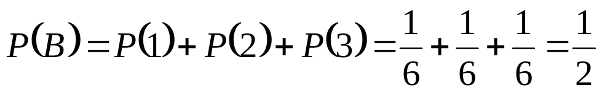
Example
Find the probability that a single toss of a die will result in a number less than 4 if (a) no other information is given and (b) it is given that the toss resulted in an odd number.
Let B denote the event {less than 4}. Since B is the union of the events 1, 2, or 3 turning up, we see by theorem 5 that
assuming equal probabilities for the sample points.

Slide 21
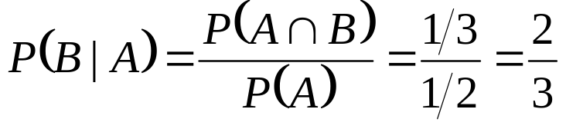
Example
Letting A be the event {odd number}, we see that P(A) = 3/6 = 1/2. Also P(A ∩ B) = 2/6 = 1/3. Then
Hence, the added knowledge that the toss results in an odd number raises the probability from 1/2 to 2/3.

Slide 22
Theorems on Conditional Probability
For any three events A₁, A₂, A₃, we have
P(A₁ ∩ A₂ ∩ A₃) = P(A₁)P(A₂ | A₁)P(A₃ | A₁ ∩ A₂)
In words, the probability that A₁ and A₂ and A₃ all occur is equal to the probability that A₁ occurs times the probability that A₂ occurs given that A₁ has occurred times the probability that A₃ occurs given that both A₁ and A₂ have occurred. The result is easily generalized to n events.
If an event A must result in one of the mutually exclusive events A₁, A₂,…, A_{n}, then
P(A) = P(A₁)P(A | A₁) + P(A₂)P(A | A₂) +…+ P(A_{n})P(A | A_{n})
(Rule of Elimination)

Slide 23
Independent Events/ Multiplicative Rules
If P(B | A) = P(B), i.e., the probability of B occurring is not affected by the occurrence or non-occurrence of A, then we say that A and B are independent events. This is equivalent to
P(A ∩ B) = P(A)P(B)
We say that three events A₁, A₂, A₃ are independent if they are pairwise independent:
P(A_{j} ∩ A_{k}) = P(A_{j})P(A_{k}) j ≠ k where j, k = 1, 2, 3
and
P(A₁ ∩ A₂ ∩ A₃) = P(A₁)P(A₂)P(A₃)

Slide 24
Independent Events/ Multiplicative Rules
If in an experiment the events A and B can both occur, then
P(A ∩ B) = P(A)P(B|A)
Thus the probability that both A and B occur is equal to the probability that A occurs multiplied by the probability that B occurs, given that A occurs. Since the events A ∩ B and B ∩ A are equivalent, we can also write
P(A ∩ B) = P(B ∩ A) = P(B)P(A|B)

Slide 25
Independent Events
Two events A and B are independent if and only if
P(B | A) = P(B) or P(A | B) = P(A)
provided the existences of the conditional probabilities. Otherwise, A and B are dependent.

Slide 26
Total Probability Rule
For any events A and B,
P(B) = P(B ∩ A) + P(B ∩ A′) = P(B | A)P(A) + P(B | A′)P(A′)

Slide 27
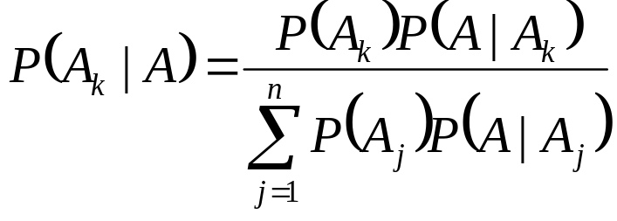
Bayes’ Theorem or Rule
Suppose that A₁, A₂,…, A_{n} are mutually exclusive events whose union is the sample space S, i.e., one of the events must occur. Then if A is any event, we have the following important theorem
This enables us to find the probabilities of the various events A₁, A₂,…, A_{n} that can cause A to occur. For this reason Bayes’ theorem is often referred to as a theorem on the probability of causes.

Slide 28
Rule of Elimination
Example 2.38 In a certain assembly plant, three machines, B₁, B₂, and B₃, make 30%, 45%, and 25%, respectively of the products. It is known from past experience that 2%, 3%, and 2% of the products made by each machine, respectively, are defective. Now, suppose that a finished product is randomly selected. What is the probability that it is defective?
Solution: Consider the following events:
A: the product is defective,
B₁: the product is made by machine B₁,
B₂: the product is made by machine B₂,
B₃: the product is made by machine B₃.

Slide 29
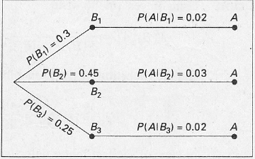
Rule of Elimination
Applying the rule of elimination, we can write
P(A) = P(B₁)P(A | B₁) + P(B₂)P(A | B₂) + P(B₃)P(A | B₃).
Referring to the tree diagram of Figure 2.13, we find that the three branches give the probabilities
P(B₁)P(A | B₁) = (0.3)(0.02) = 0.006,
P(B₂)P(A | B₂) = (0.45)(0.03) = 0.0135,
P(B₃)P(A | B₃) = (0.25)(0.02) = 0.005,

Slide 30
Rule of Elimination
and hence
P(A) = 0.006 + 0.0135 + 0.005 = 0.0245.
Instead of asking for P(A), by the rule of elimination, suppose that we now consider the problem of finding the conditional probability P(B_{i} | A) in Example 2.38. In other words, suppose that a product was randomly selected and it is defective. What is the probability that this product was made by machine B_{i}? Questions of this type can be answered by using Baye’s Rule.

Slide 31
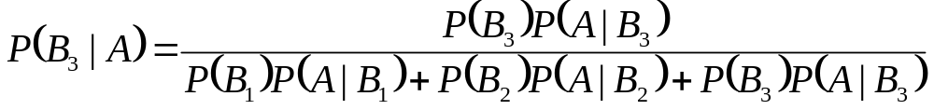
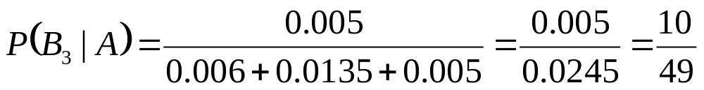
Bayes’ Rule
Example 2.39 With reference to Example 2.38, if a product were chosen randomly and found to be defective, what is the probability that it was made by machine B₃?
Solution: Using Baye’s Rule to write
and then substituting the probabilities calculated in Example 2.38, we have

